Slide 1
HISTORY COMING TO LIFE
Presented by -
Pranav Bansod Rishabh Pattewar
Hrithika Charukula Pranav Dange

Slide 2



Project Team
Pranav Dange
Hrithika Charukula
B.TECH in Industrial Engineering
BSc in Math, Statistics and .Computer Science
Pranav Bansod
Rishabh Pattewar
B.E. in Computer Engineering
.
BBA in Marketing .

Slide 3
AGENDA
Problem Statement
Solution
Sample Dataset
Work Flow of the Model
Impacts and Benefits
Timeline of the Project
Final Comments

Slide 4
Problem Statement

Slide 5
History is just so boring!!!
The most common result why Students hate history is because they find it boring.
No Interactive way of learning.
Long and boring content in the textbooks.
No way to build up curiosity in student for a specific person.
Information on Internet is just superabundant.

Slide 6
Solution

Slide 7
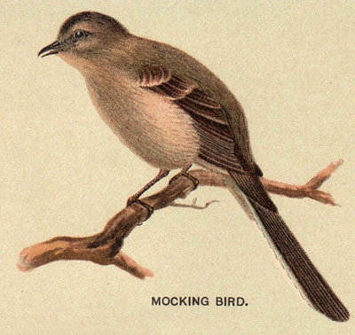
A PICTURE IS WORTH A THOUSAND WORDS
A complex idea can be conveyed with just a single image, namely making it possible to absorb large amounts of data quickly.

Slide 8
Integration of History and Technology
It may be tough not always having the extra resources to take students back in time, but technology makes it easy.
Through “History - Coming to Life” we are offering a complete self learning yet interactive platform for anyone who wants to learn, understand and develop curiosity about any person on the earth.(Whose presence is on internet).
Using Data Science - Deep Learning and NLP we intent to make a person alive on your computer screen.

Slide 9
Work Flow

Slide 10
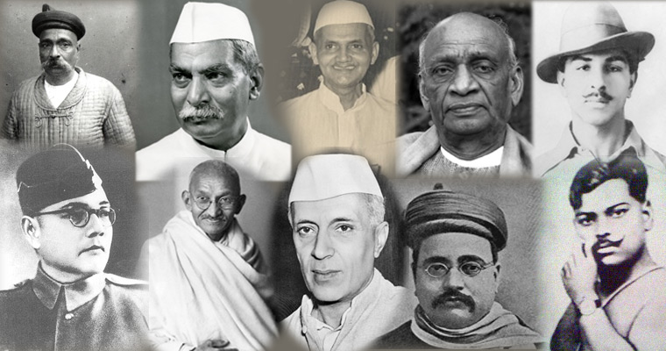
Input
Image Fetching & Deepfake Generation
Text Summarization & Text-to-Speech
Output

Slide 11

Categories :
Class 5th History NCERT
Class 6th History NCERT
Class 7th History NCERT
Class 8th History NCERT
Search Box
Output
Example: Mahatma Gandhi
Related Events of Mahatma Gandhi
Dandi March
South African Struggle
Quit India Movement
Deepfake Video
Input
Summarized Text About Mahatma Gandhi with voice

Slide 12
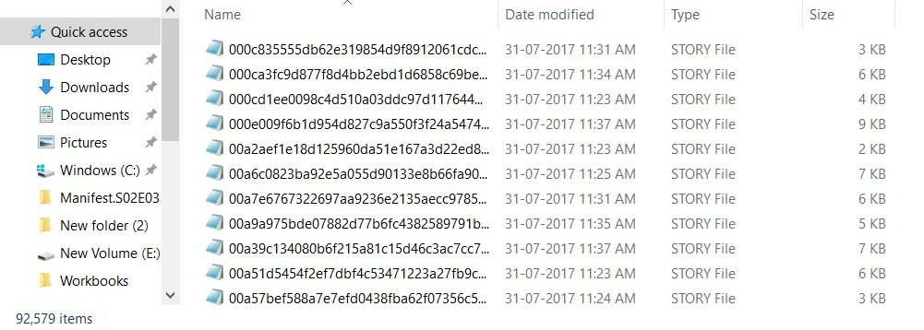
CNN-Daily Mail Dataset
Sample Dataset

Slide 13
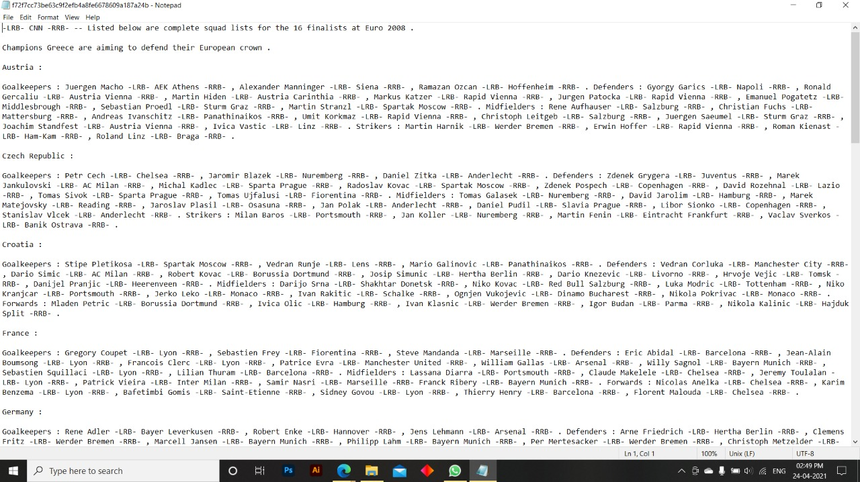

Slide 14
Benefits and Impact

Slide 15
Benefits and Social Impact
Developing Interest regarding the subject and personalities.
Experimental Learning enhances knowledge and skills.
Till date, there is no real good use of technologies like Deepfake and justification of these technologies for learning purpose.
Allows the user to Comprehend more - it is always best to tag user experience and emotions with learning .

Slide 16
Project Timeline

Slide 17

Project Timeline
Capstone Project Introduction
Model Building
Completion of Model Building
Reading up research papers.
Starting of building Deepfake and Text Summarization models.
Integration of Deepfake and Text Summarization models.
Starting to work on Deployment.
Selection of groups
Problem identification
Staring of data gathering
Feb 25, 2021
April, 2021
June, 2021
Jul, 2021
Final Day Presentation
Ready with the implementation of model.
Completion of project and grading.
Apr 24, 2021
May, 2021
Zero Day Presentation
45th Day Presentation
Presenting the work done until then.
Receiving feedbacks for further improvements.
Presenting a problem statement.
Presenting the gathered data.

Slide 18
Final Comments

Slide 19
Final Comments
The first aim is to make a generalized model which has the potential to search and apply Deepfake (using Transfer Learning) on any person whose image is available on the internet.
The summarized text of the individual we are looking for must be relevant, knowledgeable and concise.
The model should follow all the best practices of learning and must be Usable, Findable, Credible, Desirable, Accessible and Valuable.

Slide 20
We aim at creating a deep learning model which in the best interest targets on students/ anyone who aims to learn and develop curiosity by bringing person to life and making it into experience based – learning.

Slide 21

THANKS!

